Slide 1
2024 ERC Basketball Playoff Brackets

Slide 2
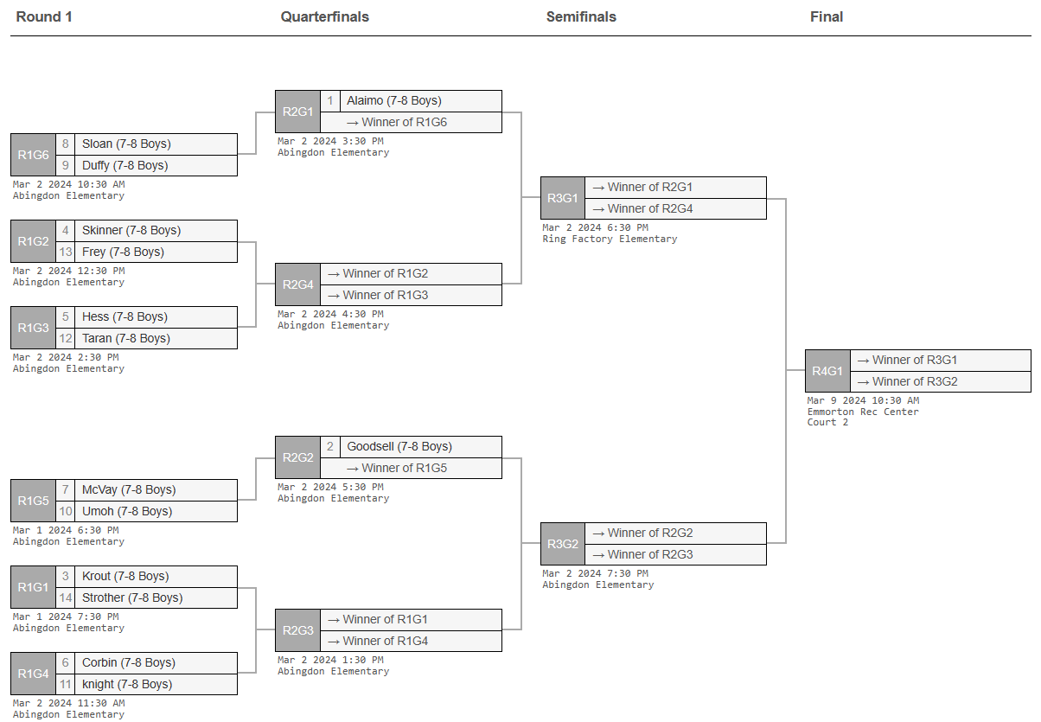
7-8 Boys

Slide 3
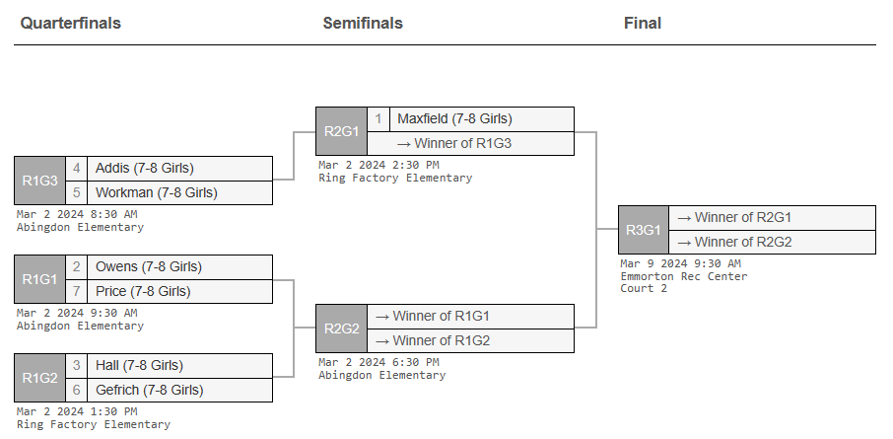
7-8 Girls

Slide 4
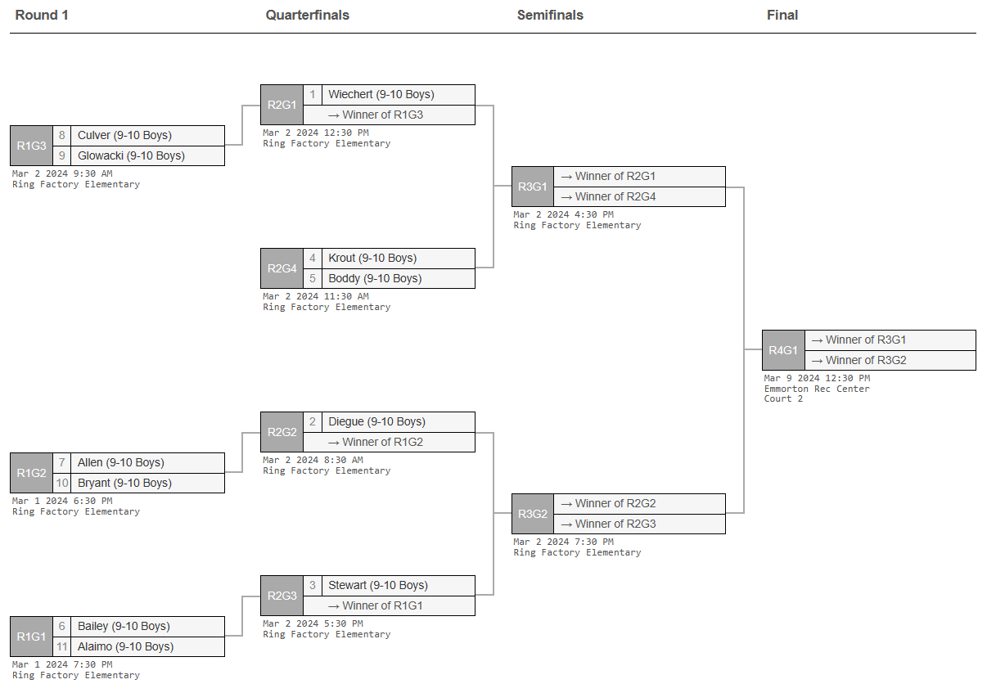
9-10 Boys

Slide 5
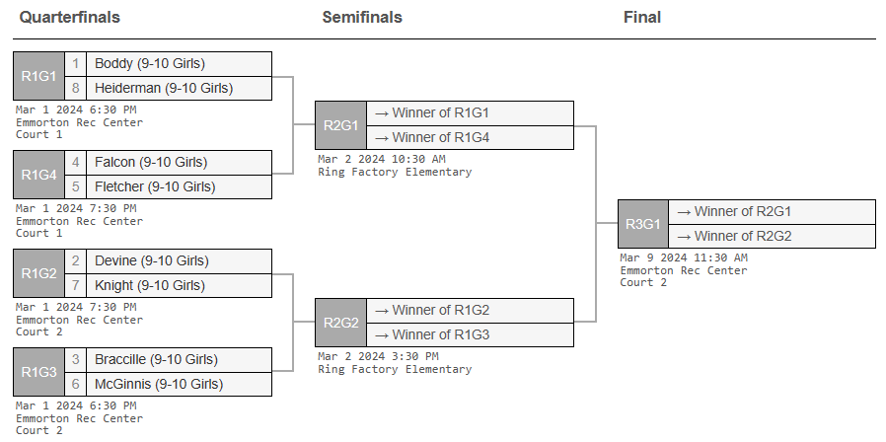
9-10 Girls

Slide 6
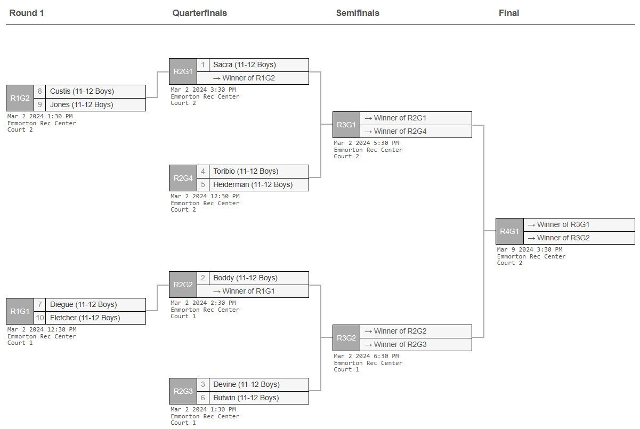
11-12 Boys

Slide 7
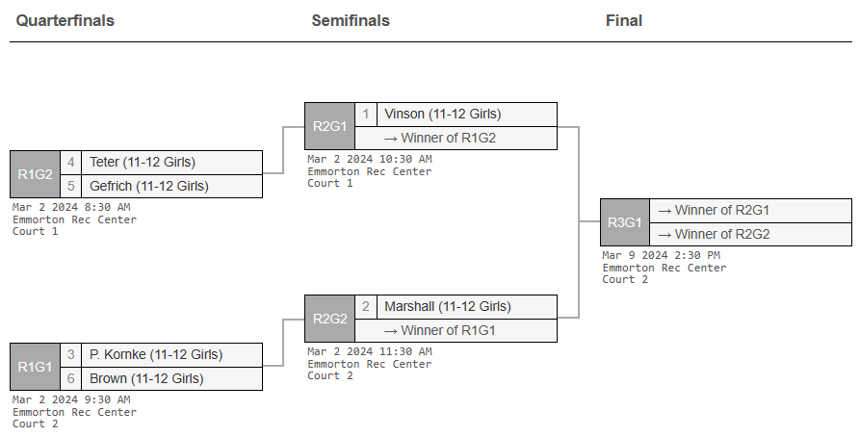
11-12 Girls

Slide 8
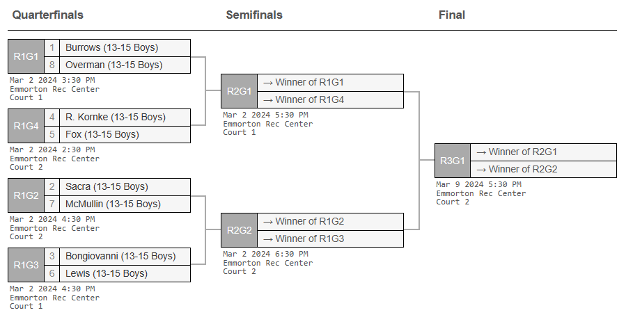
13-15 Boys

Slide 9
13-15 Girls

